Slide 1
How Students use the Services available from Lindenwood Universities Library
Student Assessment Scholars
Jennifer Sailor & Meredith Pool-Boerding

Slide 2
Outline
Introduction
Related Work
Methods
Results
Discussion
Conclusion
References

Slide 3



Slide 4
Motivation & Goals
Develop Qualitative Research Skills
Choose Stakeholder
Stakeholder Meeting
Related Work
Set Up
Focus Groups
Personal Review
Data Analysis

Slide 5
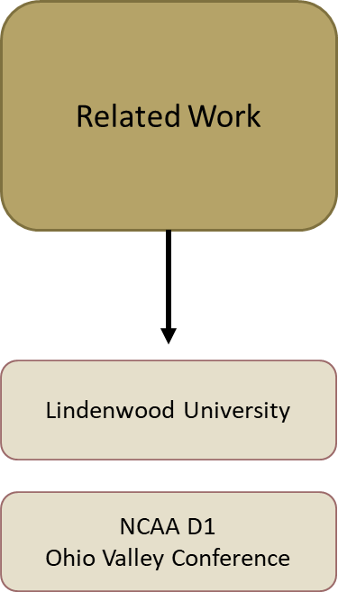
Methods

Slide 6







Literature Review

Slide 7
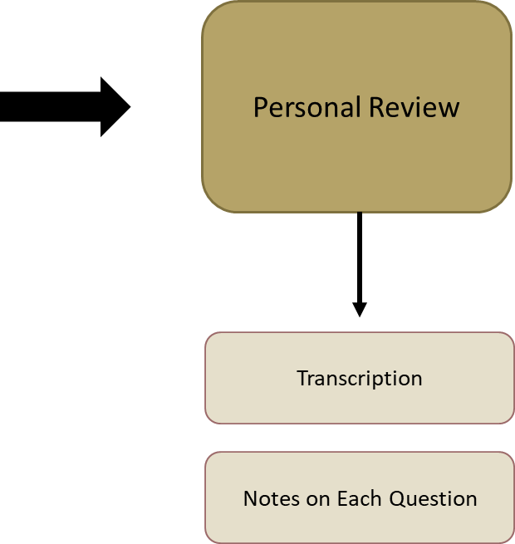
Methods

Slide 8
Appendix B:
Library Services Questions
-Please name as many library services as you have experienced or are aware of
-How often do use library services?
How do you use the building?
How does Library services help you be successful in your educational and professional life?
-What is one thing that you would like to see from the library services department?
I would use the services more if ___?
Any service from previous highschool or college that you wish we offered?
-What do you often consider the best thing about the library services department?
-How do you contact the library services: Instagram, Facebook, LU website?
-How/Where do you research for books or research articles, do you use the libraries search engines?
Do you rent books or use ebooks for research?
If you do, which do you prefer?
-Please describe your experiences with library staff

Slide 9
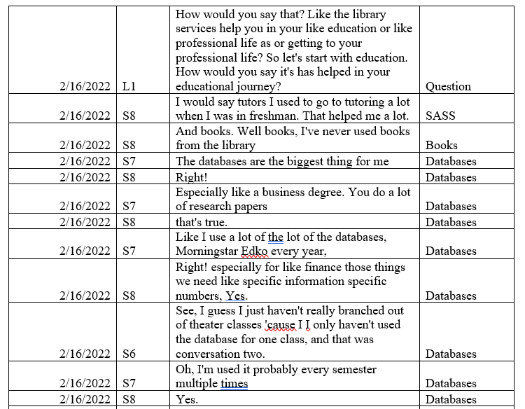
Appendix C:

Slide 10
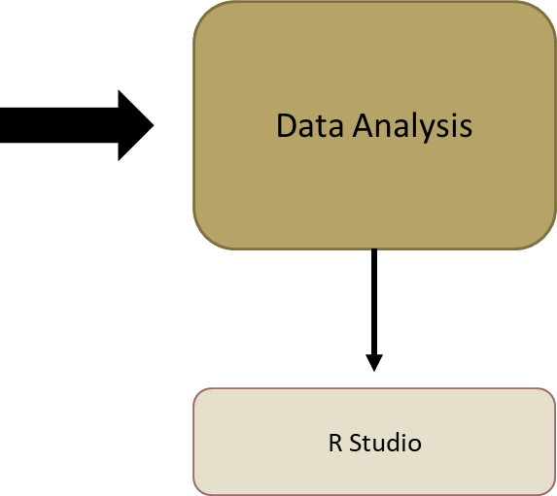
Methods

Slide 11
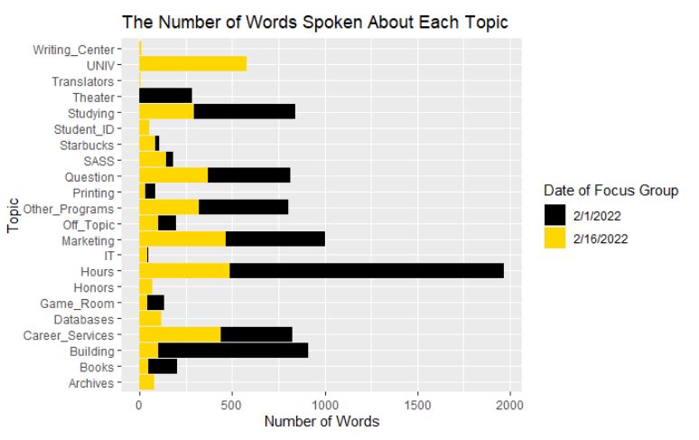
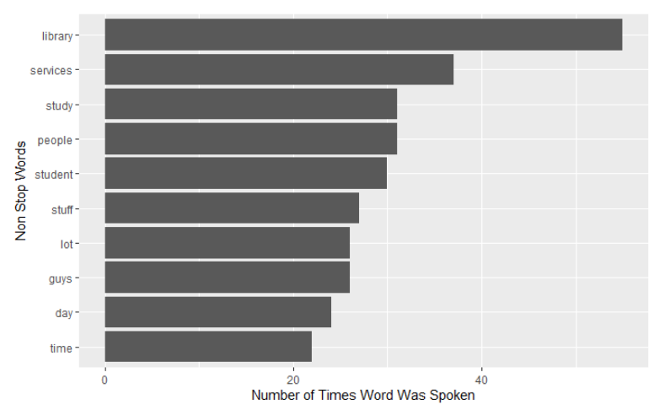
Results: What words and topics were most important?

Slide 12
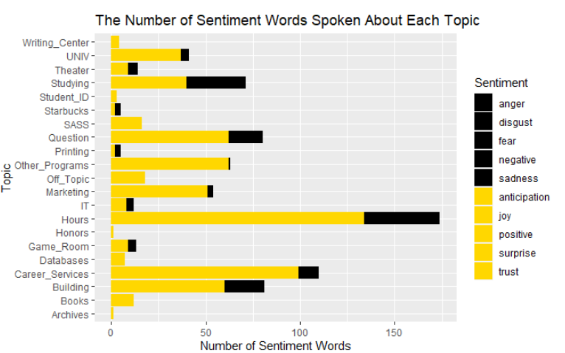
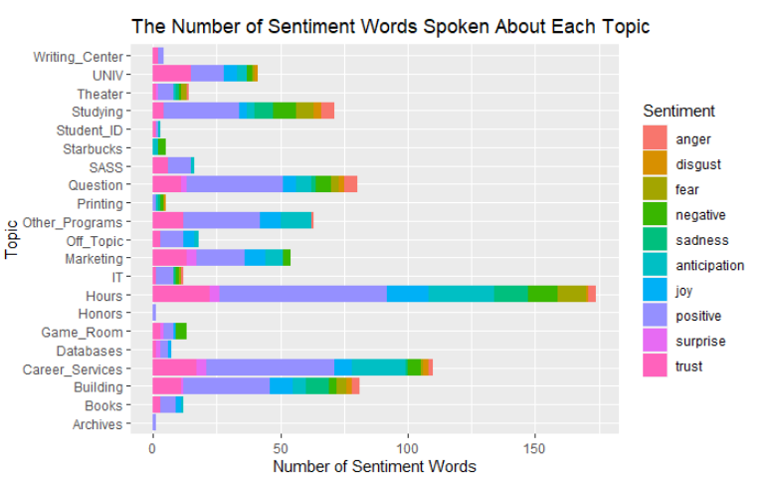
Results: What sentiment is attached with each topic?

Slide 13
Results: What sentiment is attached to the top topic?

Slide 14
Conclusion
Students use the services at Lindenwood Universities Library in various of different ways.
Students across different academic colleges use the library from never to everyday.
Students have a positive sentiment towards the Lindenwood’s Library Services.
Students want longer hours, better marketing, and find one of the best services being the building itself.
Lindenwood Universities Library Services are similar to the other schools in the athletic conference.
The LARC is currently open 78 hours a week and the average of the other school’s library hours is 92

Slide 15
Proposals: Short Term
Hours
Marketing
Study Rooms
Theater
Puzzles on Tables

Slide 16
Proposals: Long Term
Study Rooms
Marketing
Tables
Renting
Printing
Events
Adobe Suite

Slide 17
Discussion
Limitations:
Rescheduling
Diversity
Lack of Underclassman
Lack of Student Athletes
Researchers Bias

Slide 18
Citations
(1) Lindenwood Library. Lindenwood University. Retrieved March 14, 2022, from https://www.lindenwood.edu/library/
(2) Library Annual Report 2018-19 . (2019). Lindenwood University. Retrieved March 14, 2022, from https://www.lindenwood.edu/files/resources/library-annual-report-2018-19-1.pdf
(3) Felix G. Woodward Library. Austin Peay University. Retrieved March 14, 2022, from https://library.apsu.edu/#
(4) Booth library. Eastern Illinois University. Retrieved March 14, 2022, from https://www.eiu.edu/booth/
(5) Murray State University. Murray University Libraries. Retrieved March 14, 2022, from https://lib.murraystate.edu/
(6) Library & Information Services. Southern Illinois University Edwardsville. Retrieved March 14, 2022, from https://www.siue.edu/lovejoy-library/
(7) Kent Library. Southeast Missouri State. (n.d.). Retrieved March 14, 2022, from https://library.semo.edu/
(8) Paul Meek Library . The University of Tennessee at Martin. (n.d.). Retrieved March 14, 2022, from https://www.utm.edu/library/

